Slide 1
THIS IS WHO WE ARE
Isa, Klaske, Carlie and Irene
Pius-X college, Bladel

Slide 2
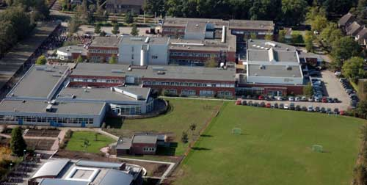
Hello Indian students, we are Isa, Klaske, Carlie and Irene. We do bilingual education at Pius-X college in Bladel. In this presentation we will tell you more about us.
This is our school: Pius-X College.
This is our class.

Slide 3
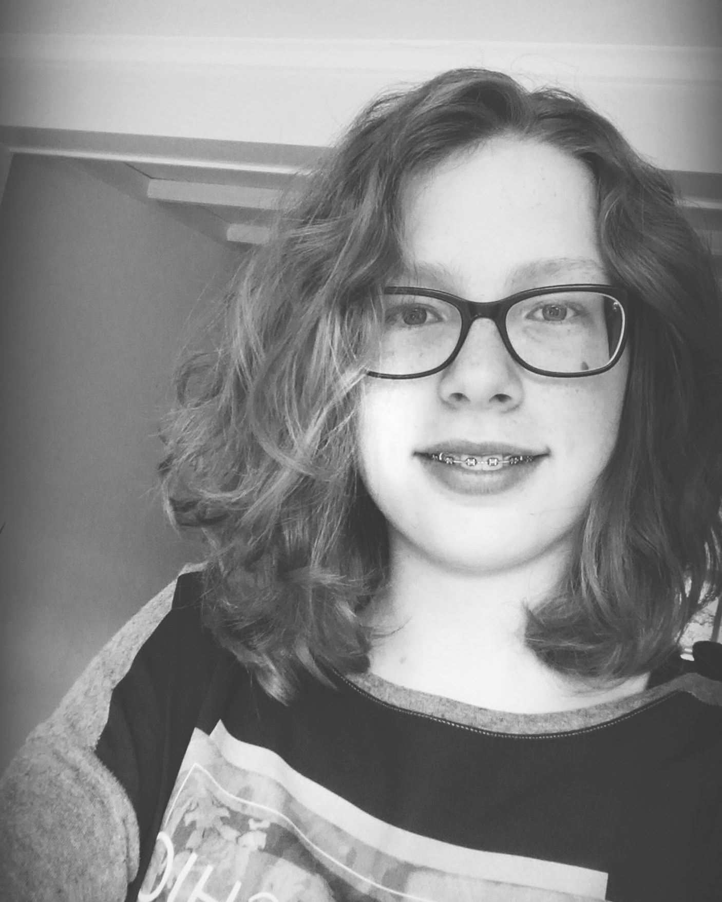
ISA
Hello, I am Isa. I am fourteen years old and my hobbies are drawing
and painting and listening to music.
This is me

Slide 4
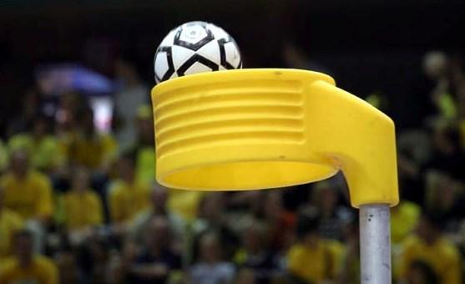
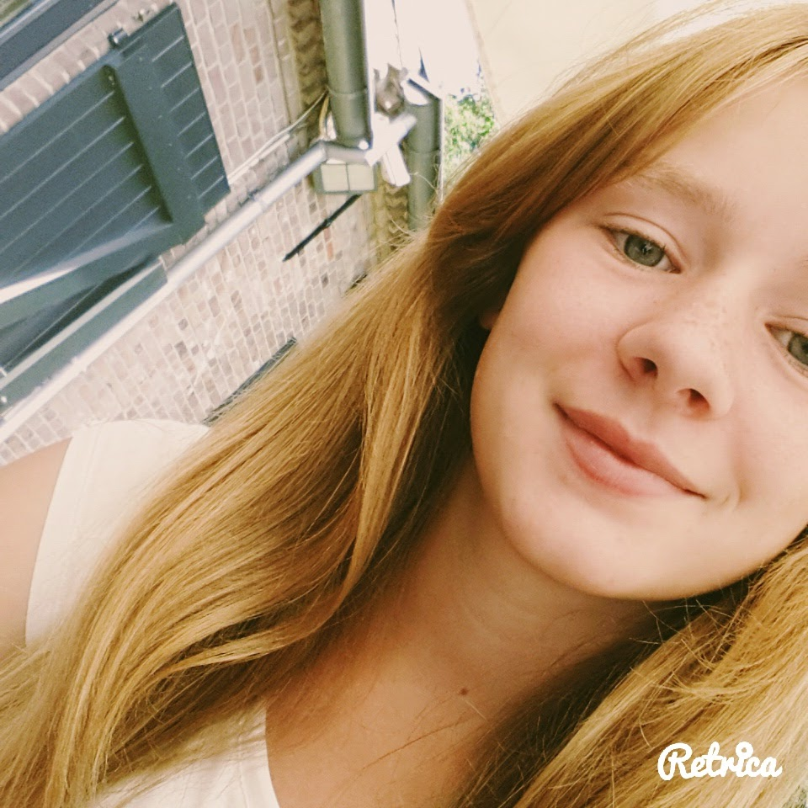
KLASKE
Hello , my name is Klaske I'm 14 years old. My hobbies are korfball and dancing.
This is korfball.
This is me.
kor

Slide 5
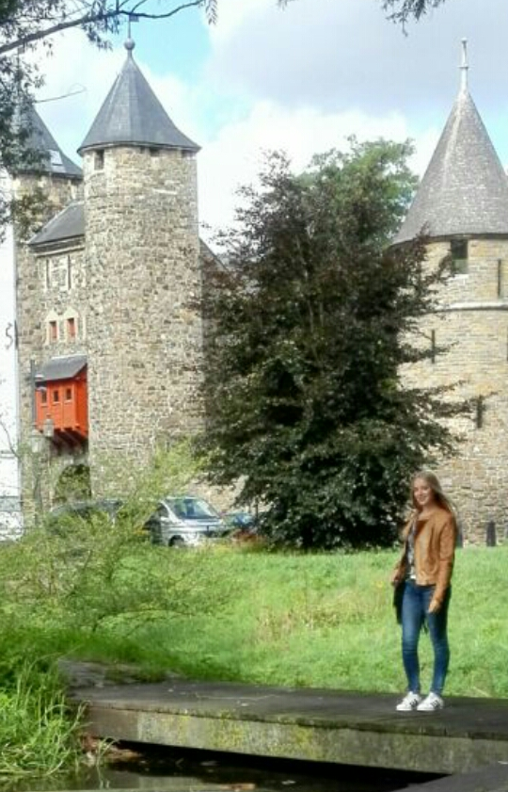
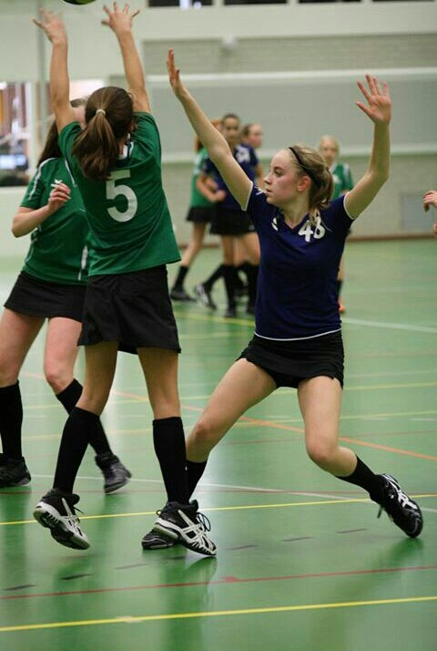
CARLIE
Hello, I am Carlie. I am fourteen years old. I play korfbal and I love to listen to music.
Me in Maastricht
Me playing korfbal

Slide 6
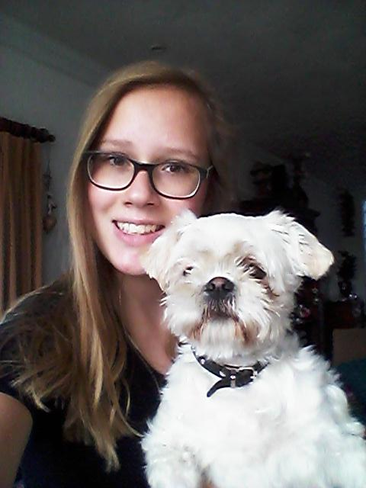
IRENE
Hello, my name is Irene I'm fourteen years old. My hobbies are playing the piano and playing hockey.
Me together with my dog Bibi

Slide 7
THE END

