Slide 1
Mathetics in sports
By Niels, Walter, Jur and Rick

Slide 2
Table of Contents
How to score and save a penalty in football
How to choose the best formation in football
Evaluation

Slide 3
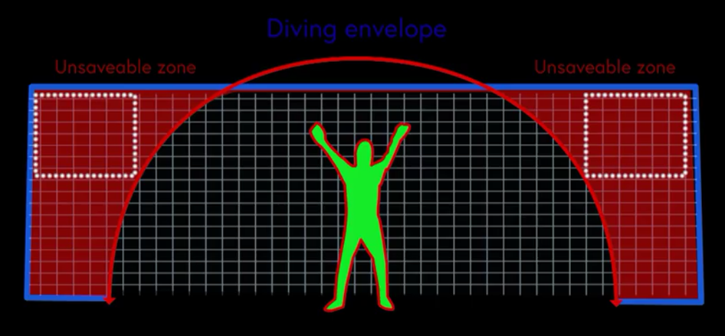
How to score and save a penalty in football
How to have the biggest chance of scoring a penalty
How to have the biggest chance of saving a penalty
https://youtu.be/Bbxb9wyH_lw

Slide 4
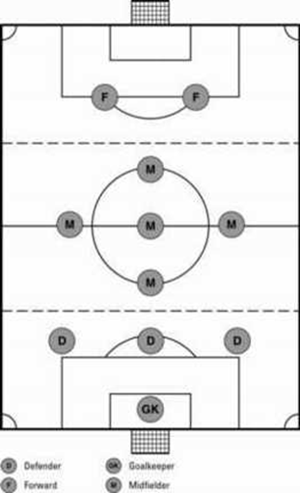
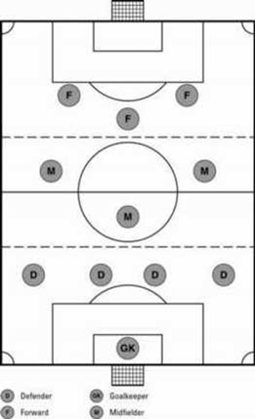
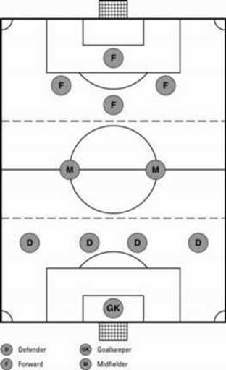
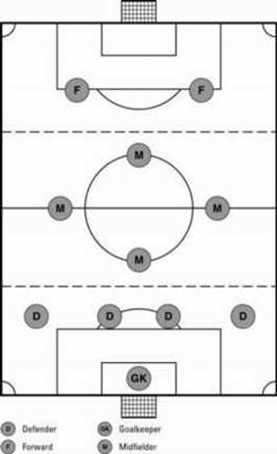
How to choose the best formation in football
4 formations:
4-4-2
4-3-3
4-2-4
3-5-2

Slide 5
Evaluation

