Slide 1
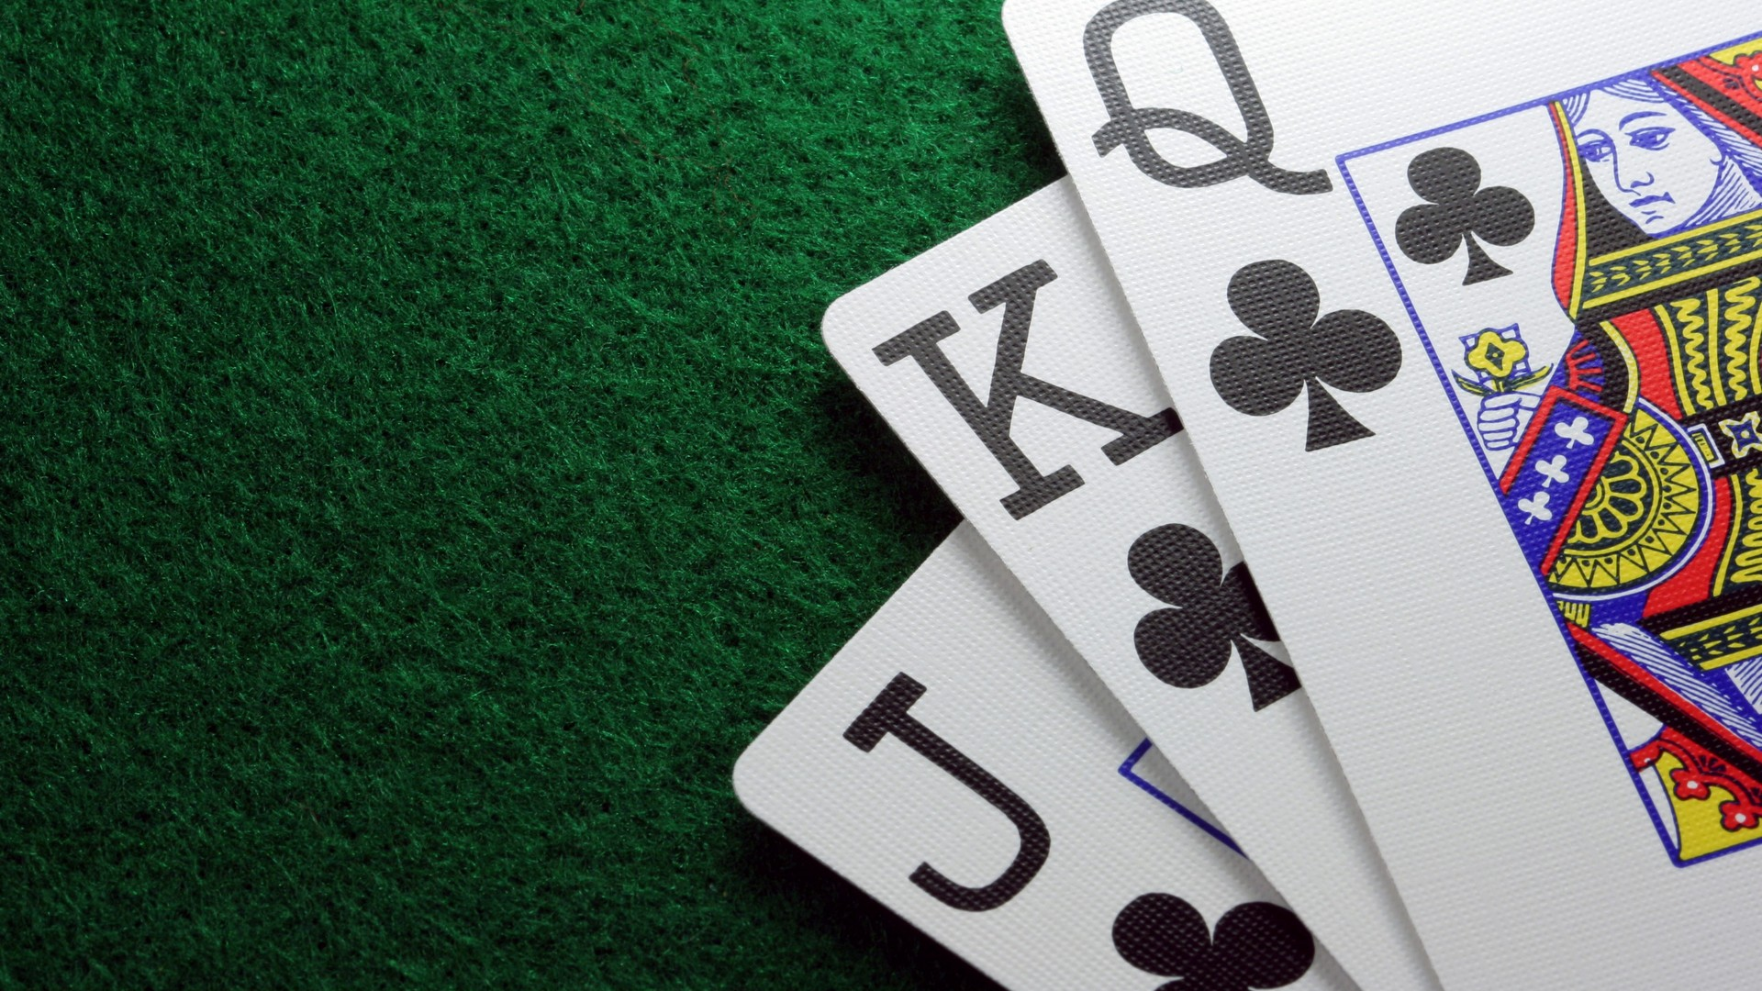
21 card trick Marc Morelli
Carlie Wijnen, Irene Wouters,
Isa Kraayvanger and Klaske Galema

Slide 2
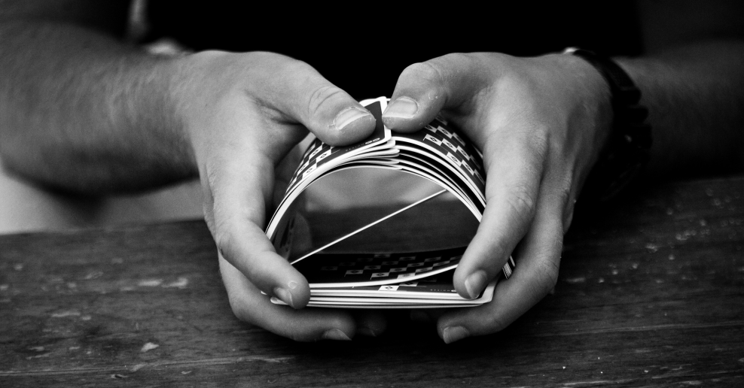
Hello Indian students,
Our topic is mathematics and tricks, because of that
we wanted to try to contact a Dutch magician. We
contacted Marc Morelli and he replied. He sent us
an video. In this video he explains a trick and this
presentation is about that trick: The 21 card trick.

Slide 3
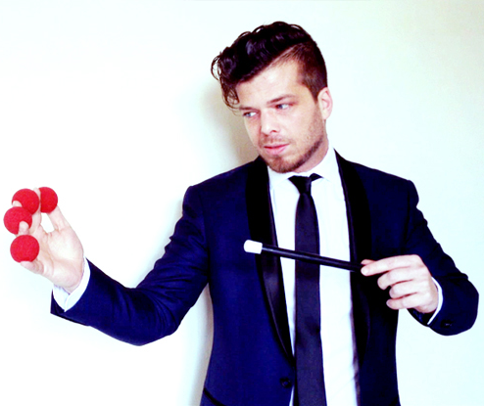
Marc Morelli
Marc Morelli is a Dutch magician. He works together
with his partner Magic Mike. Together they
participated in the tv-programma: Mindmasters live.
Marc does a lot of small
but impressive tricks. The 21
card trick is the first trick he
Has ever learned. That is the
reason why he sent us
this trick.

Slide 4
The 21 card trick
The video, which Marc send us is in Dutch. Because of that you can watch the Dutch video and you can read on the next slide the steps in English.
The 21 card trick

Slide 5
The steps
You need 21 cards for this trick.
The spectator has to choose 1 card. This person should look at the card, but not show it to the magician. Then the spectator has to put the card on top of the other cards.
The magician makes 3 rows of 7 cards.
The spectator has to tell in which ROW his card is.
The magician takes one of the 2 other rows and puts it on top of the row with the card of the spectator. After that he takes the other row. (The row WITH the card of the spectator is now in the middle.)
The magician repeats step 2+3+4.
The magician repeats step 2+3+4 again.
Now the magician tells the spectator that he is going to ‘feel’ which card the spectator chose at the beginning. The magician has to count the cards and stop when he is at card 11, because this is the spectator’s card.

Slide 6
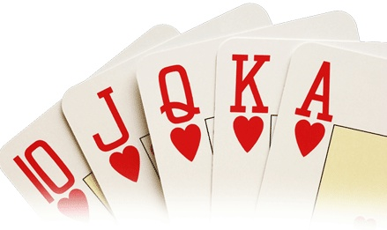
But why?
Maybe you wonder why the eleventh card is always the card of the spectator.
This explanation was not in the video, so we had to discover that by ourselves.

Slide 7
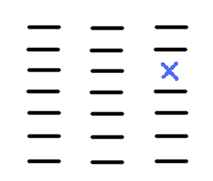
Discovering the mathematics
First take a card and look which one it is.
Then put the cards on the table and look where the card is in the rows.
The blue cross is the correct card
for example.
The stripes are other cards.
Now you have to take the
Cards in the correct order.(row
3 should be in the middle)
1 2 3

Slide 8
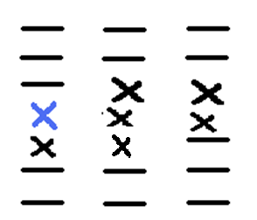
Put the cards on the table again.
Now one of the crosses has to be the correct card because those 7 come from row 3.
The row with the correct card
has to be put in the middle
again when you take the
cards.
1 2 3

Slide 9
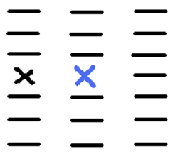
Put the cards for the last time on the table.
Now the correct card is in the middle row of one of the three rows.
The cards of the correct row are
put in the middle of the steck.
The correct card is always exactly in
the middle, so the 11th card.
Now take the 11th card of the
steck and…
Tadaaa there is the correct card.
1 2 3

Slide 10
THE END
We hope you understand the trick and that you liked it!

